Slide 1
Laboratory Basics
Some How-To’s of Laboratory Orders, Specimens, and Testing

Slide 2
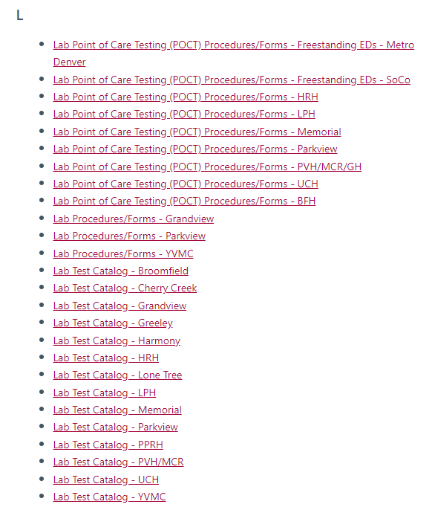
How to Find and Order Lab Tests
Most routine tests can be found using an order search in Epic when you’re adding orders.
For rare or special tests, the best place to look is in the laboratory test catalog.
These can be found for each hospital / site on the Source > Apps > “L” -- Lab Test Catalog
This will link you to a search for tests and give you all the information you need, including test number, specimen requirements, specimen stability, special transport requirements, critical values, and so much more!

Slide 3
Problems Ordering Lab Tests
“Where should I click?”
We’re sorry, but we honestly don’t know.
Our lab view in Epic is completely different than the care staff view,
so we aren’t able to tell you how to navigate in Epic.
You have questions about a test, what to draw, what swab to collect, whether a specimen is needed?
Call the lab. We’ll be here for you.
You have questions about how to navigate, what to click, where to go?
Contact the IT department’s Epic team.

Slide 4
Specimen Collection and Labeling
To get the RIGHT RESULTS on the RIGHT PATIENT you need to do these things EVERY time you collect a specimen (It looks like yelling because this is SO IMPORTANT!)
Identify the patient using two unique identifiers on the patient’s armband (name, DOB, MRN). Room number is NOT an acceptable way to identify your patient.
Patient doesn’t have a readable armband? Re-armband your patient immediately.
Double check that the specimen labels match the patient armband before putting them on the specimen, and label the specimens at bedside before taking the specimens out of the room. Many specimens are mislabeled because this step is skipped and the nurse has the wrong labels.
Bedside testing -- be sure to scan the patient’s armband on their arm, not a barcode on a chart or separate documentation.
Blood Bank / Transfusion specimens need to be initialed by two staff at bedside – two people must check armband, labels, and then initial the label. If the tube isn’t initialed by two staff members at the bedside we cannot use it for Blood Bank testing and the patient will have to be recollected.

Slide 5
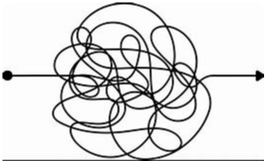
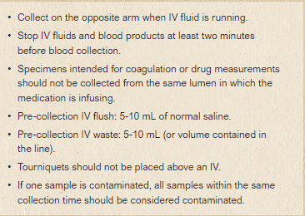
Specimen Contamination
IV fluid runs UPHILL!
…And sometimes sideways or downhill if the patient has poor circulation or you run up against a valve.
Sometimes the lab results are so wrong that we KNOW the specimen is contaminated. Sometimes the results are wrong but we can’t tell.
Contaminated specimens can cause erroneous results and bad treatment decisions!
Here are some important tips to prevent sample contamination:

Slide 6
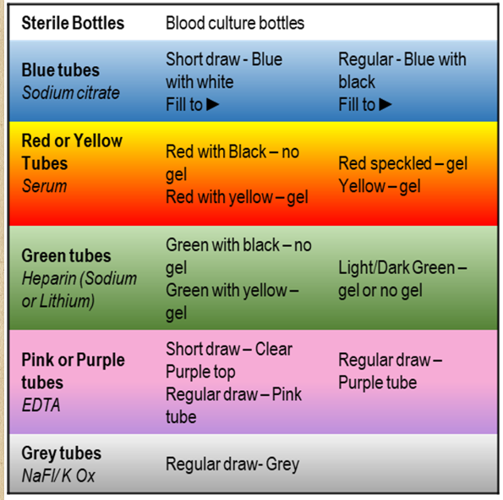
Order of Draw
Mom said I could go first!
Petey Purple Top
Billy Blue Top
Order of draw really does matter for lab specimens, whether collected by syringe or tube adapter. Additives from one tube can contaminate the next tube.
This is the correct order to prevent problems:

Slide 7
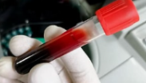
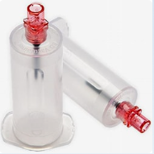
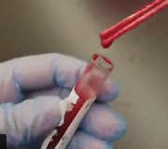
Filling Tubes and Specimen Containers
Always fill blood tubes using the vacuum of the tube to fill – forcing the specimen in the tube can cause hemolysis or over-fill.
Specimens might have to be rejected if they’re hemolyzed, clotted,
short samples, not labeled correctly, or leaking.
(Contrary to popular belief, the lab doesn’t reject specimens just for fun.
It causes us more work too!)
To help prevent hemolysis, draw specimens gently or with a tube adapter.
To help prevent clotting, gently invert tubes multiple times immediately after drawing to get the blood mixed with the anticoagulant in the tube.
If you set the tube down and pick it up to invert it later it might be too late. Clots can happen fast!
Give us all the information we need, esp. on tissue specimens – What organ? right or left?

Slide 8
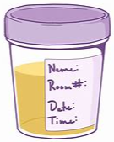
Filling Tubes and Specimen Containers
Some tests can be run on short draws, but BLUE TOP tubes
must be filled to the arrow on the tube for accurate results.
(Who knew there was an arrow?!)
If you’re sending a sample cup be sure to secure the lid tightly! Leaking can contaminate the specimen, contaminate the pneumatic tube system, and be a biohazard for lab staff.

Slide 9
How To Attach Labels
It might seem picky, but labels need to be attached correctly to the tubes for good reasons!
Labels that aren’t attached correctly can cause miss-reads on the analyzers, jams on the analyzers, specimen destruction on the analyzers, and wasted time and risk if the specimen has to be re-labeled in the lab.
Analyzers can be down for hours if a label gets stuck and the tube dumps inside.
Don’t ask us how we know. It wasn’t pretty.
Lab Analyzer

Slide 10
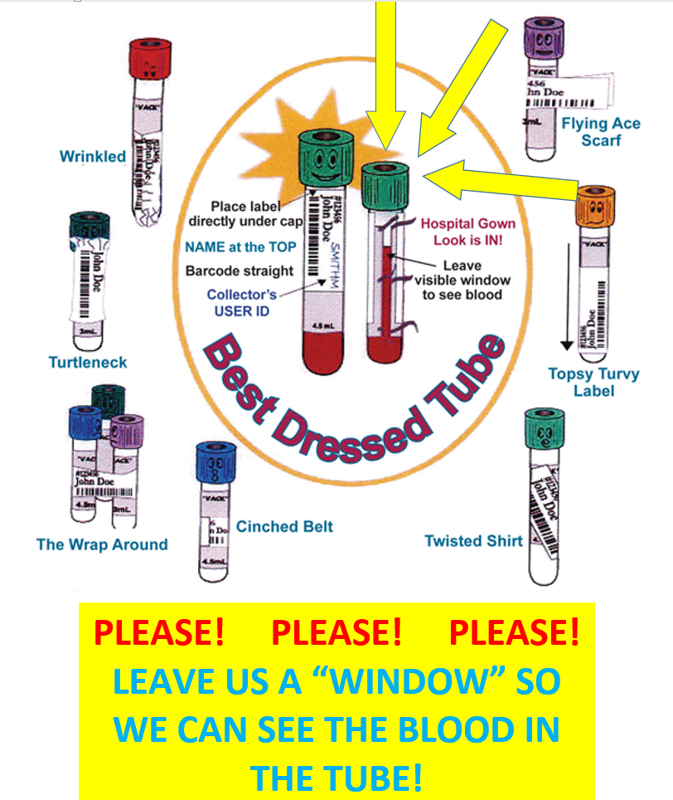
Best Dressed Labels
Study this chart!
Ok, now study it again.

Slide 11
Sending Specimens
You’ve identified the patient, collected the specimens correctly, carefully labeled the specimens at bedside after a double-check of armband and labels. Good job!! Now you have to get the specimen to the lab.
Important points to remember:
No sharps – remove any needles or puncture devices before sending the specimen
Double bag – two biohazard bags to prevent leaking, and close the zips!
Pneumatic tubes – use foam inserts when sending lab specimens if your site requires them. Check your site-specific guidelines.
Walk it down – some specimens cannot be sent through the pneumatic tube system and you’ll have to walk them to the lab. These might include blood gas specimens, difficult to collect specimens, or irreplaceable/irretrievable specimens. (“Mr. Smith, we’re sorry, but your specimen was lost and we need to collect another gall bladder.”) Check your site-specific guidelines.

Slide 12
Transfusion Orders
Emergency – uncrossmatched O blood is immediately available for emergency transfusion. Males and females >55yrs will get O Pos, females <55yrs will get O Neg.
MTP – used when patient is unstable and the anticipated need is >4 units of RBCs, along with FFP and PLTs. Please see LPH Massive Transfusion Protocol policy on The Source or search for Massive Transfusion in PolicySTAT for guidelines.
Non-emergency orders for blood – these could be routine or STAT orders, but there’s time to wait for the testing and crossmatch to be completed.
Type and Screen – order this if the patient MIGHT need blood products. You can also order blood products to be prepared and they’ll be held in the Blood Bank in case they’re needed.
Blood Bank Hold – order this if there’s a remote possibility of needing blood and you would have plenty of time to wait if blood is needed. No testing is performed and the specimen is just held in the Blood Bank.

Slide 13
Transfusion Orders
Emergency blood needed – call the Blood Bank!
Non-emergency orders for blood are a 3 part order in the Transfusion order set in Epic:
Type and Screen – patient will be tested for blood type and unexpected antibodies.
If the patient has no historic or current antibodies we can crossmatch blood in 5-10 minutes. Order Type and Screen if transfusion is possible but not likely.
If the patient has historic or current antibodies blood products will take longer to prepare. This may take hours, depending on antibodies and blood availability. Order early and often if your patient might need blood!
Order/Prepare – this specifies what type of blood product and how many units should be prepared for the patient. If not transfused the units will go back into general inventory. Order Prepare blood products if transfusion is likely or might be needed fast. The blood bank will prepare units for the patient and hold them until needed.
3. Transfuse – this is automatically added to Product orders in Epic and is held. Releasing the Transfuse order lets the blood bank know that the unit is needed for the patient and should be sent to the care unit.
HOT TIP! If you’re having trouble scanning a blood product into Epic during transfusion,
order another Transfuse order all by itself, then scan the unit into that new order instead!

Slide 14
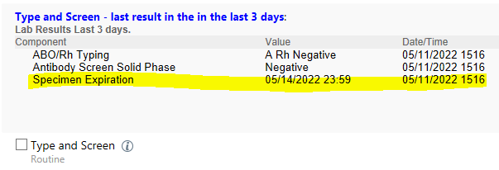
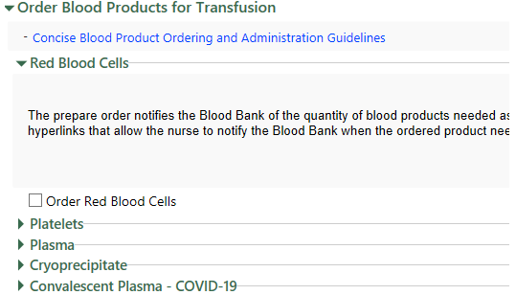
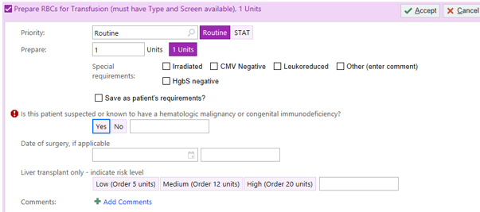
Entering Transfusion Orders in Epic
Emergency blood needed – call the Blood Bank! Then order the Massive Transfusion Protocol and Emergent Blood Transfusion order in Epic.
For non-emergency orders:
Use the UCH Blood Administration order set to order:
Check if the patient has a current Type and Screen or you need to order one:
Drop down the product you need us to prepare for the patient:
This opens a box to specify priority, number of units, and
any special needs:
DON’T FORGET CONSENT!
The Transfuse order is automatically selected and held. When the blood product is ready to go and you’re ready to transfuse you’ll release this Transfuse order and we’ll send you the unit.

Slide 15
Point of Care Testing – Bedside Testing
FAQs
I’m a new staff member. How do I get access on the meters?
Your manager will enter a POC New User request when you’re hired. Some training is online and some is in person, so you’ll get an email with instructions when the request is entered. Follow those instructions carefully.
Where can I find test procedures for point of care tests?
The Source, of course! Go to The Source > Apps > “L” to find the links to testing procedures at your site.
Juicy tidbit – inspectors love to ask poor, unsuspecting floor staff where they would find testing procedures. Be sure you’re familiar with how to find these on the Source!
I’m locked out of the meter. What do I do?
First, DO NOT use another staff member’s number to do testing. Have someone else do the patient testing until you can complete your requirements and your access is restored. Using someone else’s badge number may result in disciplinary action. (Seriously… just don’t do it.)
Second, contact your site-specific POC coordinator or office. They’ll be able to determine why you’re locked out and what you need to do to get access back.
Well this is a pain – how did I get locked out of the meter?
Your POC coordinator or team agrees with you – it’s a pain for us, too. You probably missed a deadline for your training, 6 month, or annual certification on that test or meter.
The best thing you can do to make sure you don’t get locked out is complete your training, 6 month, or annual certifications on time and follow the instructions carefully so you don’t miss a step. For example, you might have finished the online quiz and reading, but did you remember to go run QC on the meter?

Slide 16
Questions Do you need clarity on anything lab related? Contact your preceptor or the laboratory. Thank you!

