Slide 1
Natriuretic Peptides
Scientific Evidence Supporting Analytical and Clinical Application
Kim Wood MLS(ASCP)^{cm}
Clinical Specialist – Core Lab
Roche Diagnostics
Roche Confidential - Do not Copy or Distribute © 2022 Roche
Notes:
Thank you everyone for your time today. [Intro]. If there are any questions as I go through these slides, feel free to interrupt me. I’ll explain the differences between BNP and NT-proBNP, as well as show some data highlighting their clinical utility.

Slide 2
Characteristics of B-Type Natriuretic Peptides
D
R
I
S
M
S
K
S
R
S
C
G
F
C
L
1
10
70
76
C
C
S
G
K
H₂N–
H
P
L
G
S
P
G
S
A
S
Y
T
L
R
A
P
R
COOH
Q
G
V
L
M
V
R
R
108
77
K
BNP
H
NT-proBNP
S
P
–COOH
H₂N–
Size | 32 amino acids (AA) | 76 AA
Half-life | 20 minutes | 60-120 minutes
Stability | Up to 4 hours at room temperature | Up to 3 days at room temperature
Clearance | NP c-receptor, neutral endopeptidase (plasma & renal tubular epithelium), kidney¹ | Passively cleared, skeletal tissue, liver, kidney²
Measuring Range | 1.0-5,000 pg/ml³ | 36-35,000 pg/ml⁴
¹Chiong, J. et. al. Utility of natriuretic peptide testing in the evaluation and management of acute decompensated heart failure. Heart Failure Rev. Springer Science + Business Media, LLC. 2009; ²Kim, H. Januzzi, J. Natriuretic Peptide Testing in Heart Failure. Circulation. 2011;123:2015-2019; ³ Triage BNP, PI. REF 98200. 2006; ⁴ proBNP II STAT PI. 2014-09, V 6.0 English.
Notes:
To set a baseline understanding between the two molecules, I’m showing B-type natriuretic peptide, BNP, on the left. and N-Terminus pro-hormone B-type natriuretic peptide, or NT-proBNP, on the right. Both BNP and NT-proBNP are released from myocytes in the heart in response to stress-strain biomechanics with pressure changes. As you probably know, concentrations go up when heart failure develops or gets worse, and go down when heart failure is stable. In most cases, BNP and NT-proBNP concentrations are higher in patients with heart failure than people who have normal heart function.
There are some key differentiators, though, between the molecules and their utility as biomarkers. BNP is a bioactive hormone with a short in vivo half-life of only 20 minutes, as it is rapidly cleared by peptidases like neprilysin. Outside of the body, BNP is stable for up to 4 hours at room temperature. Alternatively, NT-proBNP is a non-active prohormone that is released from the same molecule that produces BNP. It is passively cleared by the liver and kidneys, and thus has an extended in vivo half-life of 1 to 2 hours. It’s in vitro stability is also longer, as it remains stable for up to 3 days at room temperature, and even longer if stored at 4 degrees C. The quick half-life and short stability of BNP may cause unfavorable results with the assay, whereas NT-proBNP does not have these disadvantages.

Slide 3
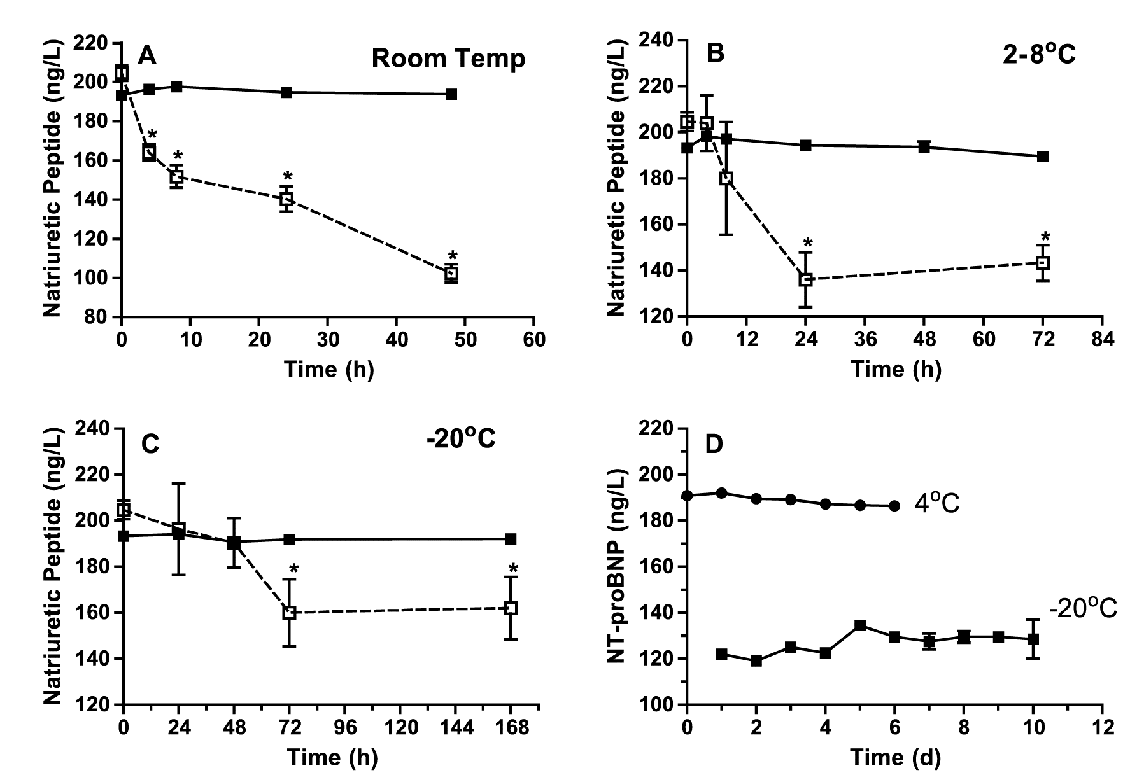
Influence of Temperature on Natriuretic Peptide Levels
Sample stability
NT-proBNP
BNP
Yeo et al. Clin Chemica Acta. 2003;338:107-115.
Notes:
To highlight the difference in sample stability, I’m showing here both molecules incubated at different temperatures. In graph A on the top left, you can see the stability of BNP decline by about half over the course 2 days at room temperature, whereas NT-proBNP remains largely unaffected. The other graphs show similar results when refrigerating or freezing the samples.

Slide 4
NT-proBNP Accuracy in Asymptomatic Heart Failure
Diagnosis primary care
Aim
Perform a head-to-head comparison of the diagnostic utility of BNP and NT-proBNP in symptomatic and asymptomatic structural heart disease
Methods
180 consecutive subjects according to ACC/AHA guidelines
BNP and NT-proBNP obtained
Mueller T et al. Clin Chim Acta. 2004;341:41-48.
Notes:
In terms of clinical data, I wanted to point out this study published back in 2004 for BNP vs. NT-proBNP use in primary care. This is a head-to-head comparison of the molecules’ diagnostic utility, with 180 subjects evaluated.

Slide 5
NT-proBNP Accuracy in Asymptomatic Heart Failure
Diagnosis primary care
Symptomatic vs asymptomatic
Asymptomatic structural disease vs no structural disease
P=.650
P=.009
AUC
NT-proBNP 0.918
BNP 0.930
AUC
NT-proBNP 0.839
BNP 0.735
Mueller T et al. Clin Chim Acta. 2004;341:41-48.
Notes:
Here, you’re seeing BNP in black and NT-proBNP in gray. On the left, with a p value of 0.65 there is no significant difference between their accuracy in diagnosing symptomatic vs. asymptomatic heart failure. What’s interesting is that on the right, with a p value of 0.009, there is a statistically significant increase in diagnostic accuracy by NT-proBNP in patients with asymptomatic structural disease vs. no structural disease. What this means is that by using NT-proBNP as a biomarker, PCPs were able to more accurately identify early stage heart failure that otherwise might not be detected by BNP or an echocardiogram.

Slide 6
Notes:
Taking a look at diagnosis per stage of heart failure, BNP captures less than 10% of patients in the early A and B stages. NT-proBNP, on the other hand, captures about 35% of these patients, with greater accuracy than BNP in Stage C and D heart failure patients as well.

Slide 7
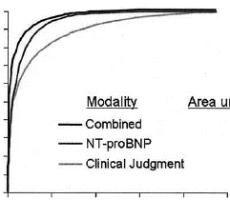
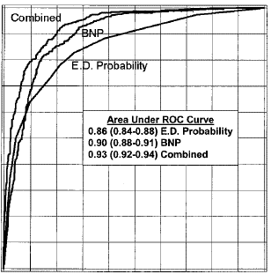
ICON- Emergency Dept Diagnosis of Acute Heart Failure
Use of Natriuretic Peptides enhance clinical judgment
NT-proBNP
BNP
1.0
1.0
1.0
Combined
0.9
0.9
BNP
0.8
0.8
0.7
E.D. Probability
0.6
0.7
Sensitivity (True Positives)
0.5
Modality Area under the curve
Combined 0.96
NT-proBNP 0.94
Critical Judgment 0.90
0.6
0.4
0.5
Area Under ROC Curve 0.86 (0.84-0.88) Probability 0.90 (0.88-0.91) BNP 0.93 (0.92-0.94) Combined
0.3
Sensitivity
0.2
0.4
0.1
0.3
0
0
0.2
0.4
0.6
0.8
1
0.2
1-Specificity (False Positives)
0.1
Receiver-operating characteristic curve comparison of NT-proBNP versus clinician-estimated likelihood for the emergency department diagnosis of acute CHF. Results of NT-proBNP testing were superior to those of clinical judgment, with significantly greater area under the curve (0.94 vs 0.90, p = 0.006). The area under the curve from NT-proBNP testing plus clinical judgment (0.96) was superior to each diagnostic modality alone.
0.0
0.0
0.1
0.2
0.3
0.4
0.5
0.6
0.7
0.8
0.9
1.0
1-Specificity
ROC curves for estimated clinical probability and BNP (P <0.001 for all pairwise comparisons of area under ROC curve.)
Januzzi et al. Am. Journal Cardiology 2005;95:948-954.
Maisel, A. et al. Circulation 2002;106:416-422.
Notes:
Evaluating the clinical utility of each assay, this study published in 2005 also demonstrated the superiority of NT-proBNP in the ED. Looking at these plots of sensitivity vs. specificity, an area under the curve of 1 would represent perfect diagnostic ability. In the NT-proBNP graph, clinical judgment alone achieved an area under the curve of 0.9. Use of NT-proBNP outperformed clinical judgement, and combining the two further increased the area to 0.96. As you can see in the BNP graph, similar trends were observed in terms of the biomarker improving diagnostic ability over clinical judgment alone, and the combined approach being best. However, the areas under these curves are all reduced compared to those of NT-proBNP. Like this study, for almost 20 years the medical data has overwhelmingly favored the use of NT-proBNP over BNP.

Slide 8
ENTRESTO™ and Natriuretic Peptide Cardiac Biomarkers
Notes:
One clear point I want to make in this presentation, as I’m often asked about this by clinicians, is that NT-proBNP is NOT affected by common heart failure medications. One significant reason why some physicians report undesirable results with the BNP assay is that their patients might be taking angiotensin receptor neprilysin inhibitors, or ARNIs, that do interfere with the BNP molecule. ENTRESTO is the common ARNI prescription, which I’ll use to point out why BNP assays can be misleading in these patients specifically.

Slide 9
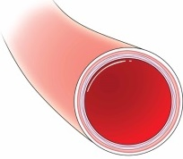
ENTRESTO Mechanism of Action
ENTRESTO
Natriuretic Peptide System
proBNP
Angiotensin Receptor Blocker (RAAS)
Neprilysin Inhibitor
NT-proBNP
BNP
X
VASODILATION
Neprilysin
Neprilysin
ENTRESTO MOA
Inhibits both RAAS and Natriuretic Peptide system
BNP levels stay elevated due to ENTRESTO
Physiological NT-proBNP not impacted by ENTRESTO
BNP
NT-proBNP levels
Not impacted by Neprilysin
Decrease with Entresto
BNP
BNP
BNP
BNP
BNP
Notes:
ENTRESTO is used to reduce the risk of hospitalization and cardiovascular death in patients with chronic heart failure, and it has a unique dual mode of action compared to conventional drug therapies. In order to cause vasodilation, ENTRESTO acts both as a RAAS inhibitor AND a neprilysin inhibitor. We know from earlier that neprilysin typically degrades BNP, and when it is inhibited by ENTRESTO, BNP concentration is artificially elevated. This mode of action with neprilysin inhibition does not affect the concentration of NT-proBNP.

Slide 10
PARADIGM-HF
Comparison of ARNI with ACEi to determine impact on mortality and morbidity
Conclusion
ARNI was superior to ACEI alone in reducing the risks of death and hospitalization for heart failure
Trial
Double–blind trial of patients with class II-VI HF; LVEF ≤0.40 (amended to ≤0.35)
Received either LCZ696 (Entresto) or ACEI (Enalapril)
Primary Outcome
Composite of Cardiovascular Death or Hospitalization for HF
Secondary Outcomes
All-cause mortality
Kansas City Cardiomyopathy Questionnaire (KCCQ) Score change at 8 months (symptoms and physical limitations)
Time to new onset atrial fibrillation
Time to first occurrence of a decline in renal function
McMurray, JJV. et al., NEJM 2014; 371: 993-1004.
Notes:
In this 2014 study, the use of ACE inhibitors and ARNIs was compared for their impact on mortality and morbidity in heart failure patients. While the overall conclusion was that ARNIs were the superior treatment, I want to hone in on the BNP and NT-proBNP measurements from that study that helped them determine this.

Slide 11
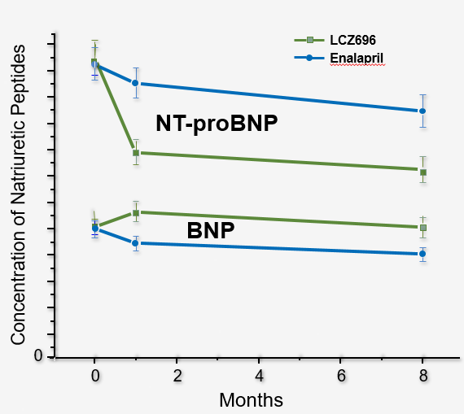
PARADIGM-HF: NT-proBNP and BNP Levels
Interpretation of NP levels
Entresto (ARNI)
Enalapril (ACE Inhib)
NT-proBNP reflects the effect of the drug on the heart
BNP reflects the action of the drug
Packer, et al. Circulation. 2015.
Notes:
Here, you see ENTRESTO in green and an ACE inhibitor in blue. Looking first at the blue lines, we see expected outcomes in both the NT-proBNP and BNP measurements - as the patient is treated with the drug, the blue lines decline indicating natriuretic peptide concentrations were decreasing successfully with treatment. Looking at the green line for Entresto, we see an even more significant decrease in NT-proBNP than with the ACE inhibitor, substantiating the conclusion drawn from this study. The problem with BNP, as I mentioned, is that patients taking ENTRESTO get an artificial rise in BNP due to the drug’s mode of action. Here, you see that BNP increases with ENTRESTO treatment, and even as it declines over the course of 8 months, the final value is still higher than baseline. This can confuse clinicians who see increasing BNP as a sign of worsening heart failure, when in reality the ENTRESTO-treated patients fared even better than those treated with an ACE inhibitor. The key takeaway here is that the rise in BNP is due to the mechanism of action of the drug, which has no clinical utility, whereas the fall in NT-proBNP reflects the drug’s actual effects on the heart which informs clinical decision-making.

Slide 12
Notes:
Even in their label, Entresto specifically urges clinicians NOT to use BNP measurements, and instead use NT-proBNP in patients treated with the drug, just to ensure there is no confusion in the assay results.
Are there any questions about this so far?

Slide 13
NT-proBNP FDA Cleared Intended Uses and Decision Thresholds
Notes:
Now that I have covered BNP vs. NT-proBNP, I want to talk about the clinical utility of our NT-proBNP test and how to interpret your results.

Slide 14
NT-proBNP Intended Use
FDA cleared
The Elecsys proBNP II assay is used as:
An aid in the diagnosis of individuals suspected of having heart failure
For risk stratification in patients with ACS and HF
An aid in the assessment of increased risk of cardiovascular events and mortality in patients at risk for heart failure who have stable coronary artery disease
Elecsys proBNP II Method Sheet, 2018-11, V 7 English
Notes:
This assay is FDA cleared to aid in heart failure diagnosis, risk-stratify patients with that diagnosis and acute coronary syndrome, and to assess the healthcare risks in heart failure patients who have stable coronary artery disease.

Slide 15
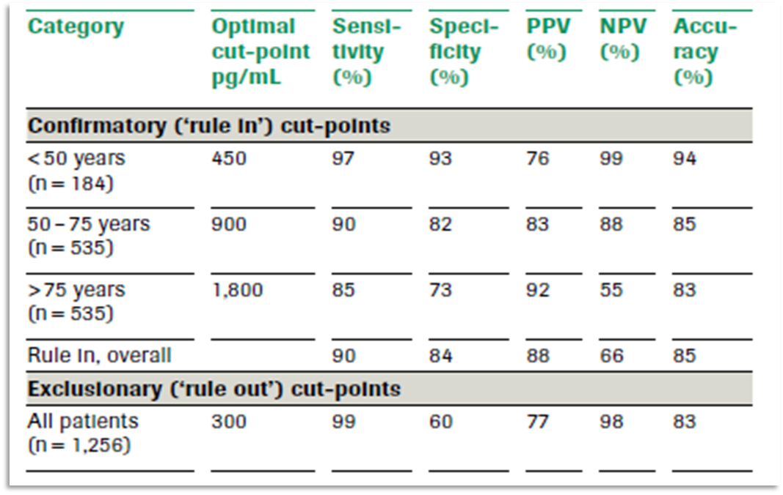
NT-proBNP ICON Decision Thresholds
Rule-Out & Rule-In Acute Population
Januzzi, J. L., et al. (2006). Eur Heart J, 27(3), 330-337
Notes:
While the BNP assay assigns a single rule-in/rule-out threshold, the NT-proBNP assay can utilize age-specific cutoffs which you see here. This is recommended in the 2019 IFCC Guidelines, since we know that the concentration of natriuretic peptides naturally increases with age. By using these specified cutoffs designed for an acute population, you increase the positive predictive value of the NT-proBNP assay. Because of this, most hospitals running NT-proBNP implement these cutoffs.
—
MOST HOSPITALS USE THE RULE-IN ICON CUTOFFS (THESE ONES)

Slide 16
NT-proBNP Method Sheet Decision Thresholds
Rule-Out & Rule-In Non-Acute Population
Patients suspected of having HF
NT-proBNP assay
Younger patient < 75 years | <125 pg/mL
Older patient ≥ 75 years | <450 pg/mL
Younger patient < 75 years | >125 pg/mL
Older patient ≥ 75 years | >450 pg/mL
Heart Failure unlikely
Additional CV assessment indicated
Elecsys proBNP II Method Sheet, 2018-11, V 7 English
Notes:
Additionally, we’ve established cutoffs in non-acute populations for patients above and below 75 years old, whereas again the BNP assay only has one rule-in/rule-out threshold. Our cutoffs are 125 pg/mL for those under 75 years old, and 450 pg/mL for those over.
—
THESE ARE ROCHE’s FDA CLEARED CUTOFFS, but most hospitals do not use them since they are based on a non-acute population. Most use the rule-in cutoffs from the ICON study.
These 125 and 450 cutoffs are not risk stratification cutoffs. Risk stratification is more trending the value, not necessarily a cutoff.

Slide 17
NT-proBNP Clinical Performance
NPV by age and sex
Males | < 45 years | 45-54 years | 55-64 years | 65-74 years | 75 + years | < 75 years
% Sensitivity | 81.6 | 88.2 | 89.6 | 91.7 | 86.5 | 89.0
95% confidence interval | 68.0-91.24 | 81.27-93.24 | 84.47-93.42 | 85.58-95.77 | 74.21-94.41 | 85.95-91.58
% specificity | 95.7 | 93.3 | 87.8 | 86.7 | 88.9 | 90.0
95% confidence interval | 78.05-99.89 | 89.07-96.31 | 82.33-91.99 | 75.59-92.07 | 77.37-95.81 | 87.14-92.32
Prevalence | 0.7 | 1.8 | 6.2 | 6.8 | 9.8 | 1.39
Negative predictive value | 100.0 | 99.8 | 99.2 | 99.3 | 98.8 | 99.8
Females | < 45 years | 45-54 years | 55-64 years | 65-74 years | 75 + years | < 75 years
% Sensitivity | 86.7 | 90.5 | 89.3 | 94.3 | 81.8 | 90.6
95% confidence interval | 59.54-98.34 | 69.62-98.83 | 78.12-95.97 | 80.84-99.30 | 64.54-93.02 | 84.08-95.02
% specificity | 84.9 | 85.5 | 79.9 | 57.8 | 87.9 | 76.7
95% confidence interval | 68.1-94.89 | 80.64-89.53 | 74.52-84.63 | 50.21-65.09 | 77.51-94.62 | 73.47-79.72
Prevalence | 0.5 | 1.3 | 3.4 | 6.6 | 9.7 | 1.16
Negative predictive value | 100.0 | 99.9 | 99.5 | 99.3 | 97.8 | 99.9
Elecsys proBNP II Method Sheet, 2018-11, V 7 English
Notes:
The NT-proBNP assay also has a high negative predictive value, or NPV, ranging from 98 to 100% depending on the patient’s age and sex. This is especially important when comparing to BNP, where the negative predictive value is largely unreported. In the landmark “Breathing Not Properly” clinical trial that was first presented in 2002, the negative predictive value of the BNP assay is cited as 90%, which is much lower than the negative predictive value here for NT-proBNP.

Slide 18
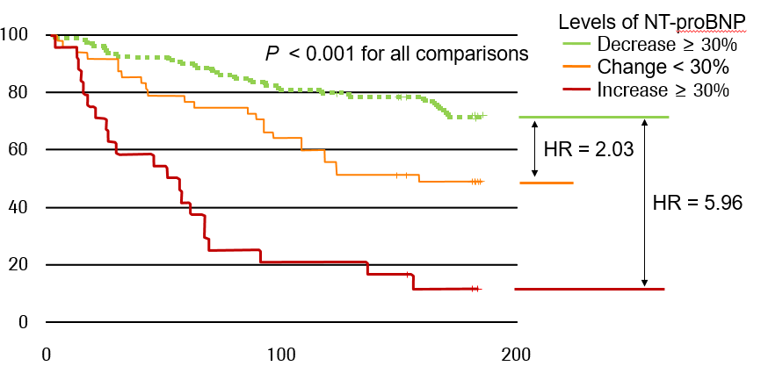
Risk Stratification in Acute Heart Failure
NT-proBNP serial measurements
Patients with no readmissions (%)
Time (days)
Bettencourt P et al. Circulation. 2004;110:2168-2174.
Notes:
This might not be as relevant in outpatient care, but I wanted to point out that serial measurement of the biomarker is also a very strong indicator of heart failure patient readmission to the hospital. Here, the green line shows patients with NT-proBNP decreases of 30% or more, who exhibited a low rate of hospital readmission over 6 months. A smaller decrease in the biomarker, noted by the orange line, resulted in more hospital readmissions, and an increase in NT-proBNP almost guaranteed hospital readmission, as shown by the red line with a hazard ratio of 5.96. This goes to show that NT-proBNP measurement is an excellent predictive tool for heart failure patients.
HR = hazard risk

Slide 19
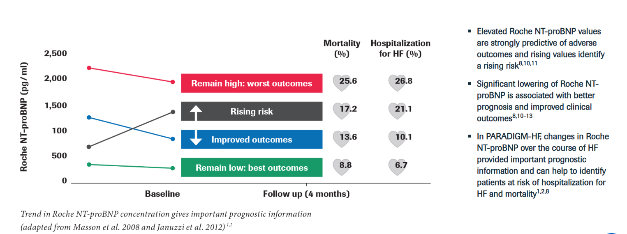
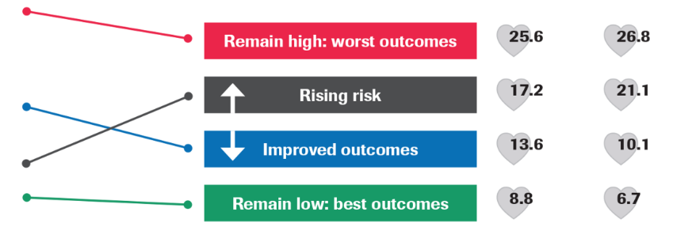
Serial NP Measurements for Prognosis in Chronic Heart Failure
Trends in NT-proBNP concentrations give important prognostic information
2,500
2,000
1,500
1,000
500
0
Mortality (%)
Hospitalization for HF (%)
Elevated Roche NT-proBNP values are strongly predictive of adverse outcomes and rising values identify a rising^{8,10,11}
Significant lowering of Roche NT-proBNP is associated with better prognosis and improved clinical outcomes^{8,10-13}
In PARADIGM-HF, changes in Roche NT-proBNP over the course of HF provided important prognostic information and can help to identify patients at risk of hospitalization for HF and mortality^{1,2,8}
Roche NT-proBNP (pg/ml)
Baseline
Follow up (4 months)
Trend in Roche NT-proBNP concentration gives important prognostic information (adapted from Masson et al. 2008 and Januzzi et al. 2012)
Masson, S. et al. J Am Coll Cardiol 2008;52:997–1003; Januzzi et al, 2012
Notes:
That fact is reiterated by this study, which showed that NT-proBNP measurement is a great prognostic. To quickly summarize the findings here, both high absolute value and elevation of the biomarker over 4 months were largely predictive of adverse outcomes, meaning greater mortality and hospitalization percentages. Decreases in the biomarker and lower absolute values were associated with a better prognosis.
—---
Starting from the bottom, a relatively low and stable NT-proBNP level was associated with the best mortality and hospitalization outcomes. In the worst case, the red line….

Slide 20
Notes:
To reiterate the key differences between NT-proBNP and BNP: First, NT-proBNP has age-stratified cutoffs which accurately represent disease status, particularly in elderly patients who will naturally have higher levels of natriuretic peptides. Additionally, the in vivo half-life and in vitro stability of NT-proBNP both exceed that of BNP, enhancing detection of heart failure in early stages while allowing for laboratory flexibility and add-on testing. These points, combined with the fact that BNP is artificially raised in patients taking ENTRESTO, point toward using NT-proBNP in heart failure diagnosis and prognostics moving forward.

Slide 21
STRONG-HF: Safety, Tolerability and efficacy of Rapid Optimization, helped by NT-proBNP testinG, of Heart Failure therapies
Mebazaa A, et al. Lancet 2022; Epub ahead of print.
DOI: 10.1016/S0140-6736(22)02076-1.
For external use | © 2022 Roche
Notes:
One last thing I want to very briefly touch on is the recent STRONG-HF study. I can do a much deeper dive into the study offline, but at this year’s American College of Cardiology conference there was a lot of buzz around this study and therapeutic monitoring with NT-proBNP. Roche does not have an FDA claim for monitoring, but this study had clinically impactful results and we expect that the guidelines may change in the near future recommending quad therapy for heart failure patients along with NT-proBNP to monitor the safety and efficacy of this therapy. Overall, patients treated with that paradigm saw a 34% risk reduction of heart failure readmission and all-cause mortality at 180 days, with no increase in serious adverse events compared to a usual care group. Given this increase in an event-free survival, the STRONG-HF protocol with consistent NT-proBNP testing is something your hospital might consider implementing into clinical practice, and again I’m happy to speak more to this study at a later date.

Slide 22
Notes:
With that, thank you for your time, and I will take any questions.

